Slide 1
Thevenin’s Theorem
Any linier circuit consisting several voltages and resistances may be replaced with one single voltage in series with single resistance connected across the load

Slide 2
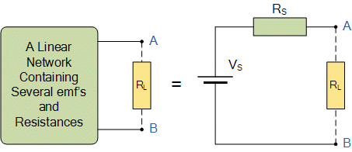
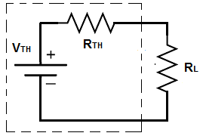

Slide 3
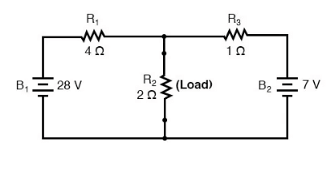
Taking an example of an electrical circuit:
This consists of three branches of electric al resistances and two sources of voltage

Slide 4
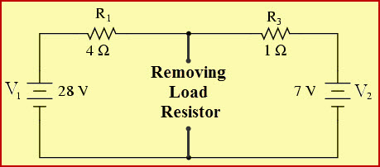
To find Thevenin,s equivalent of above circuit
We first remove the centre 2 ohm load and short out terminals.
When shorted, the two resistances become parallel across two respective voltages.

Slide 5
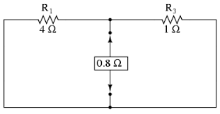
When two voltage circuits are short circuited
V=0
the two Resistances are connected in parallel. The value of equivalent Resistance is
R_{S}=R₁R₃/R₁+R₃
R_{S}=4x1 /4+1= 0.8 ohm

Slide 6
And current through loop is
I = V / R
I = (28 V - 7V) /(2+1)
i= 7A
This current is common to both resistances so voltage drop across 1ohm resistor is as
Vab=28 –(1 ohm x7 A)=21 V

Slide 7
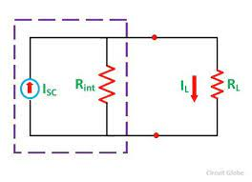
Then Thevenin’s equivalent circuit consists of 0.8 ohm in series with load resistance
I = V/R = 21V / 0.8 = RL

